Slide 1
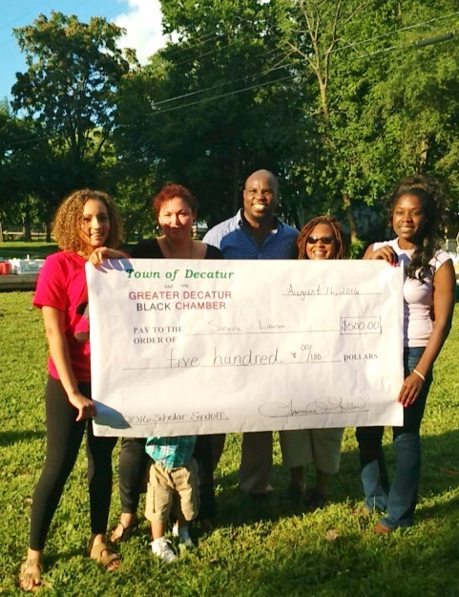
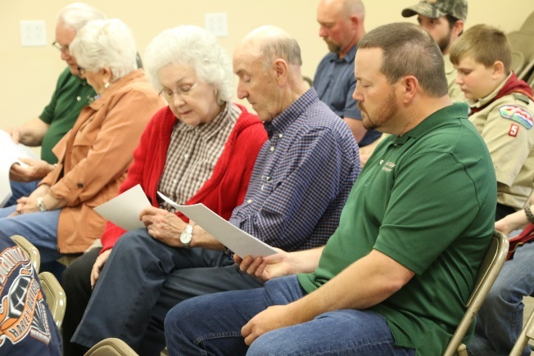
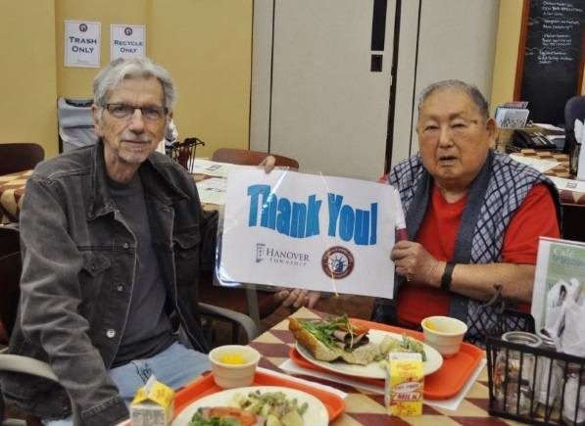
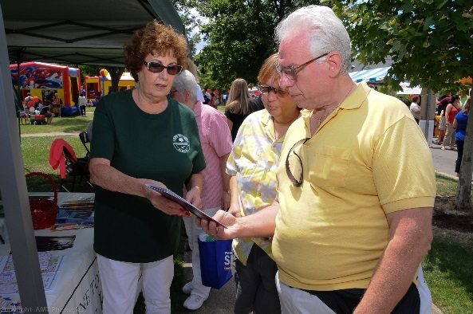
Welcome to TOI’s
2016 Educational Conference
Awards Breakfast

Slide 2
Good Friend Award
Presented by Tim Bramlet, TOI Legislative Consultant

Slide 3
Mighty Message Awards
Presented by Bryan E. Smith, TOI Executive Director

Slide 4
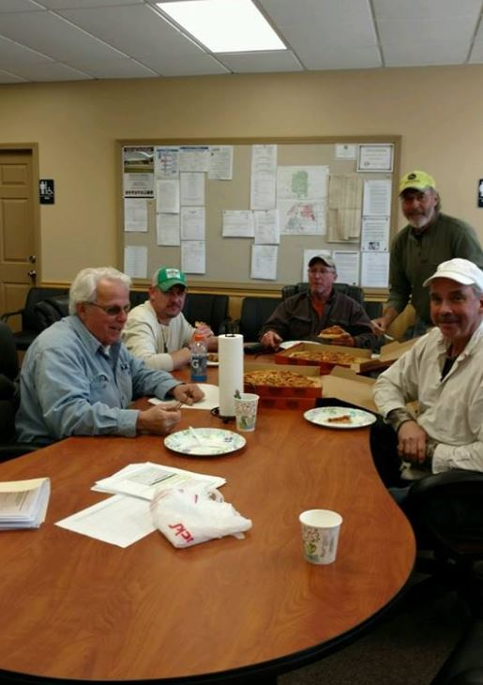
Mighty Message Awards
Best Website, Best Use of Social Media, Best Photo of a Township Event - 15,000-25,000 Population
Winner: Groveland Township, Tazewell County

Slide 5
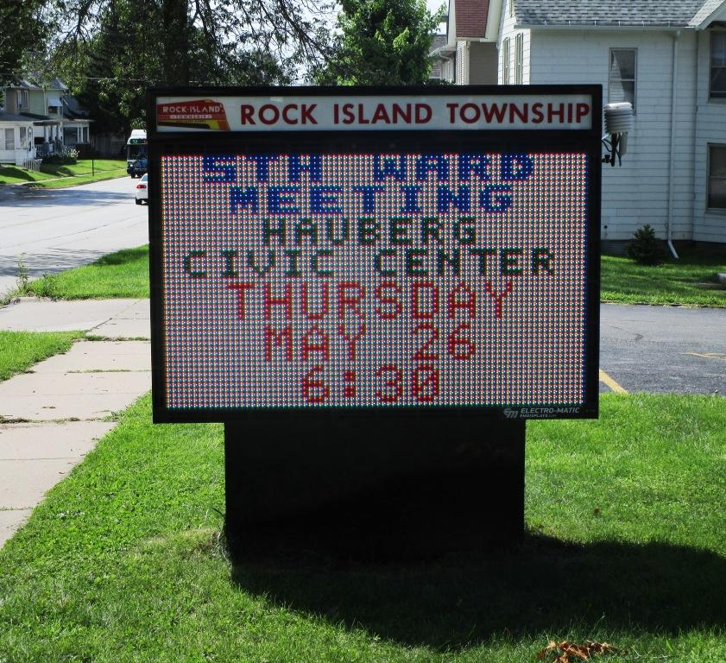
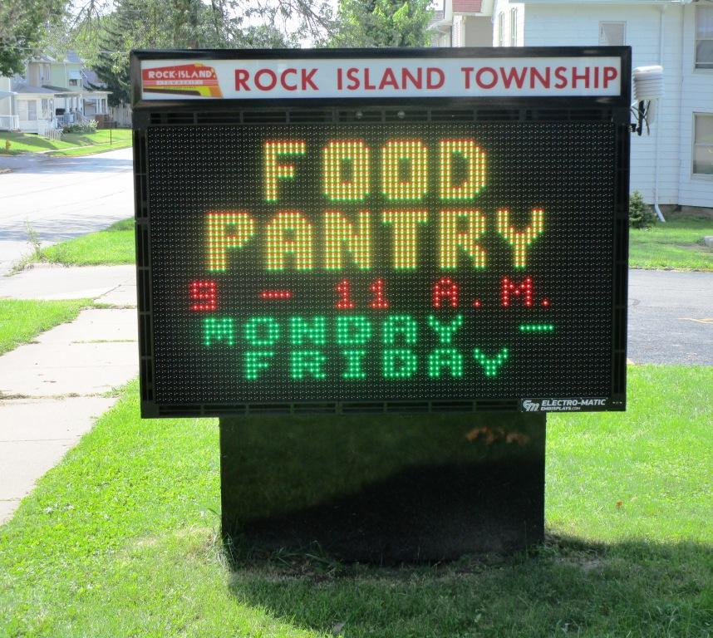
Mighty Message Awards
Best Miscellaneous/Other Communication 15,000-25,000 Population
Winner: Rock Island Township, Rock Island County

Slide 6
Mighty Message Awards
Best Newsletter, Best Website, Best Use of Social Media 25,000-50,000 Population
Winner: Fremont Township, Lake County

Slide 7
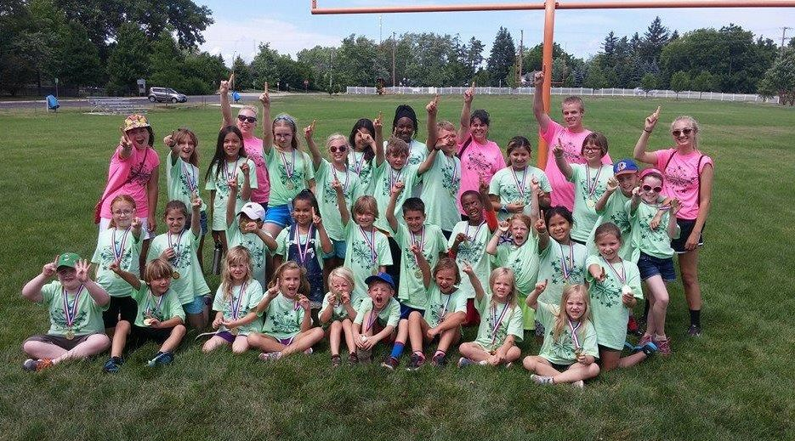
Mighty Message Awards
Best Miscellaneous/Other Communication, Best Photo of a Township Event, Best Township Program or Campaign 25,000-50,000 Population
Winner: Ela Township, Lake County

Slide 8
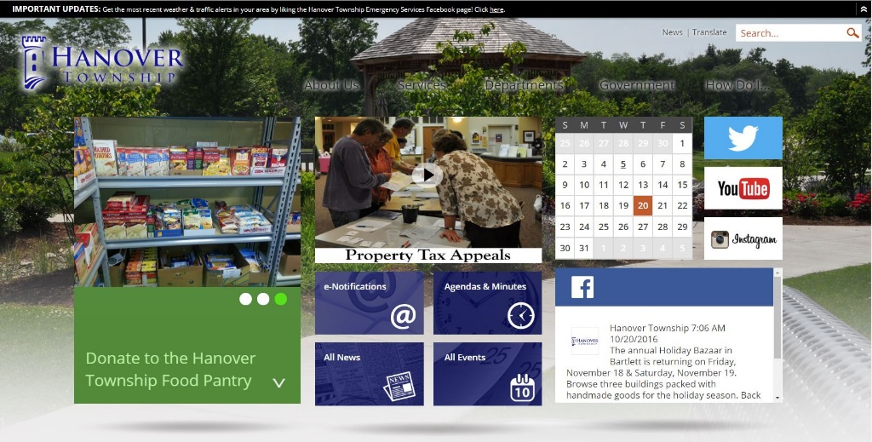
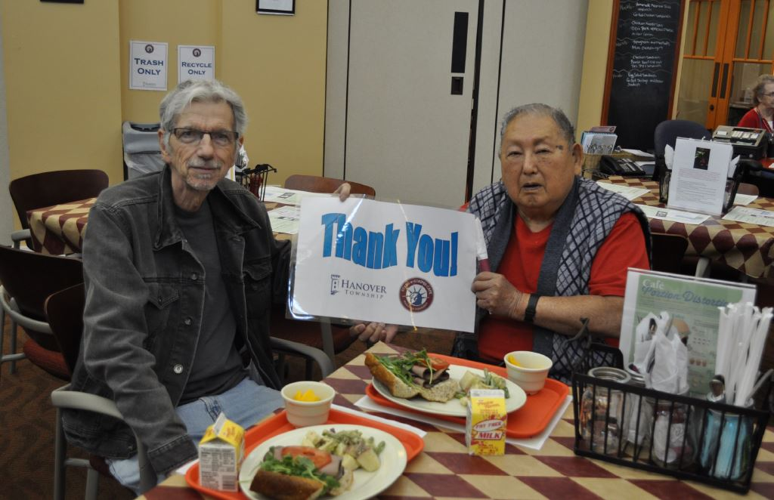
Mighty Message Awards
Best Newsletter, Best Website, Best Photo of a Township Event, Best Use of Social Media 50,000+ Population
Winner: Hanover Township, Cook County

Slide 9
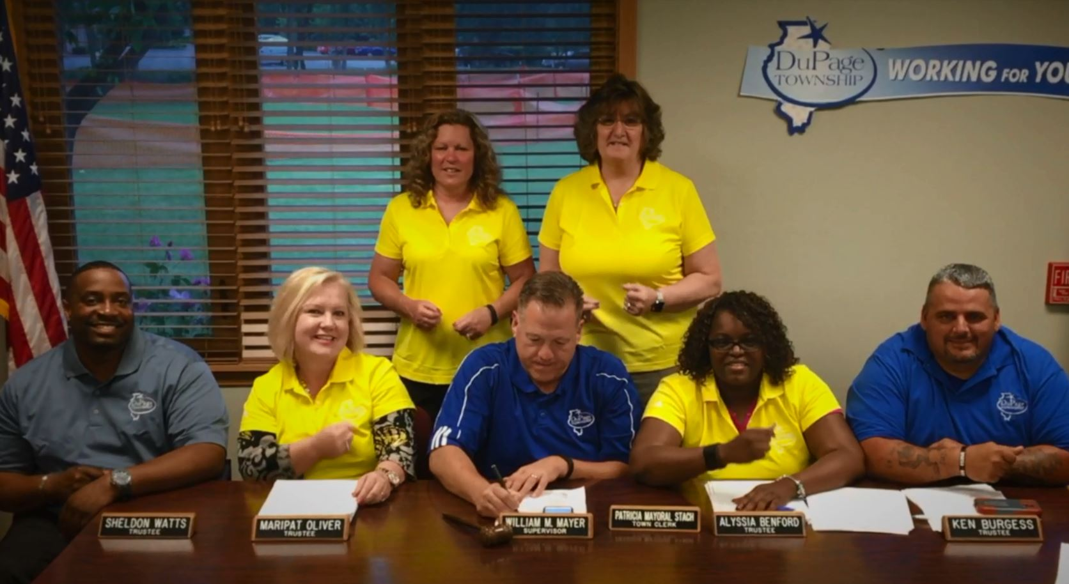
Mighty Message Awards
Best Miscellaneous/Other Communication 50,000+ Population
Winner: DuPage Township, Will County

Slide 10
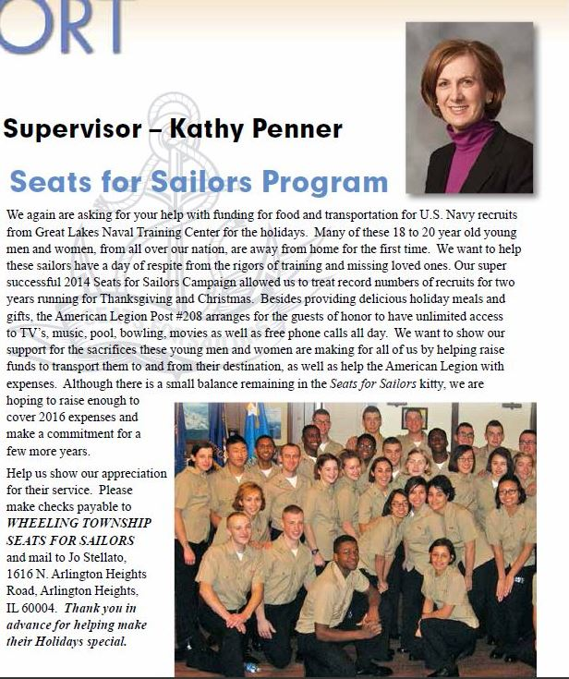
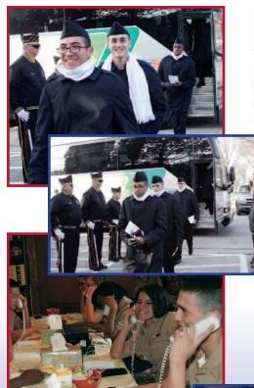
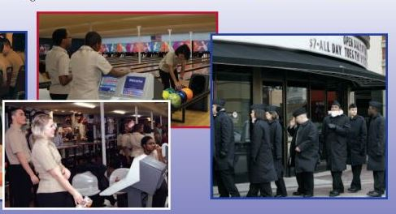
Mighty Message Awards
Best Township Program or Campaign, Best Overall Communications Winner 2016 50,000+ Population
Winner: Wheeling Township, Cook County

Slide 11
Professional Development Awards
Presented by Jerry B. Crabtree, TOI Associate Director/Education Director

Slide 12
Townships with over 70 hours of Education credit:
Rockford Township (Winnebago County)
Palos Township (Cook County)
Riverside Township (Cook County)
Morton Township (Peoria County)

Slide 13
Robert Turner Award
Presented by Michael Young, Supervisors Division President

Slide 14
Assessor of the Year
Presented by Chris Kain, Past President, Assessors Division

Slide 15
William Z. Ahrends Award
Presented by Charles Levy, Niles Twp. Clerk, Clerks Division

Slide 16
Excellence in Public Service
Presented by Mary Hamilton, President and Board Members of the Trustees Division

Slide 17
Anthony Spina Award
Presented by John M. Nelson, President, Attorneys Division

Slide 18
Social Worker of the Year Award
Presented by Mary Jo Imperato, President, Social Workers Division

Slide 19
AITCOY Award
Presented by John Parquette, President,
and Vicki Marques, Award Chair, AITCOY

Slide 20
ITASCSC Award
Presented by Susan Dillon, President,
Senior Citizens Division & Megan Conway

Slide 21
Congratulations to all award winners.
Thank you for your excellent work this year!

Slide 22
Thank you to our 2016 conference sponsors and exhibitors!

Slide 23
2016 Conference Sponsors
Platinum Sponsors

Slide 24
2016 Conference Sponsors
Gold Sponsors

Slide 25
2016 Conference Sponsors
Township Officials of Illinois Divisions
Silver Sponsor
App Sponsors

Slide 26
2016 Exhibit Hall Participants
AITCOY - The Association of Illinois Township Committees on Youth
*Allied Benefit Systems, Inc.
Ameren Illinois
Biospan Technologies
*Clarke
Ecolane
*Enbridge
*FORCE America, Inc.
Greenfield Contractors LLC
IDOT Technology Transfer Center
ITASCSC, Illinois Township Association of Senior Citizen Services Committees
Illinois Assessors Association
Illinois Municipal Retirement Fund
Illinois Township Trustees Association
Local Government Health Plan
Martin Equipment of Illinois, Inc.
Mid-West Truckers Association, Inc.
Phoenix Services LLC
*Stonehugger Cemetery Restoration
TIPS
*TOIRMA
Township Highway Commissioners of Illinois
Township Officials of Illinois
Township Officials of Illinois Clerks Division
*Visual PAMSPro
Waukegan Township
Wm. Nobbe Co.
*Woody's Municipal Supply Co.
*Associate Company Members

Slide 27
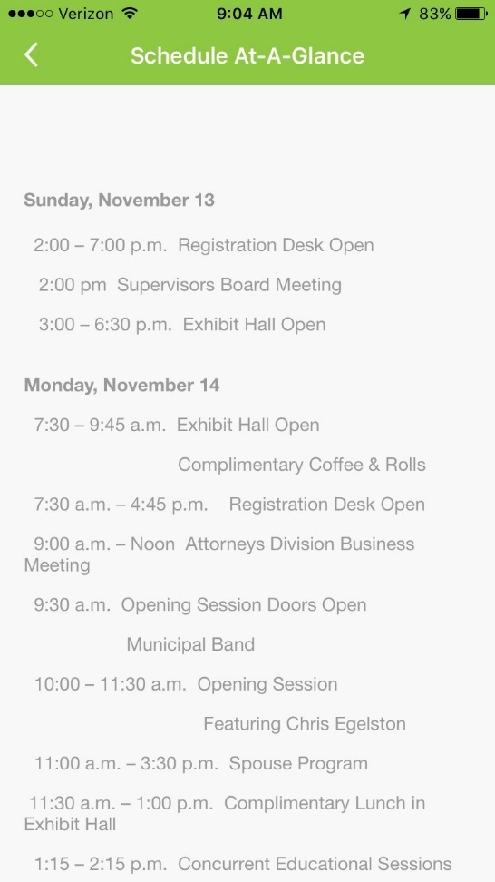
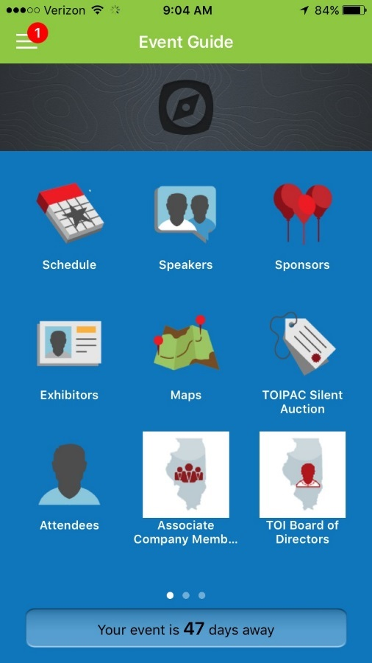
Reminders
Please download the TOI Conference App available for download through iTunes or the Google Play Store.
If you are having trouble downloading, updating, or navigating the conference app, stop by the Mobile App booth outside of the Exhibit Hall or the TOI booth inside the Exhibit Hall for help.
There is free Wi-Fi access for conference attendees at the Crowne Plaza:
Network: Crowne Plaza Conference
Password: thanks

Slide 28
Reminders
Be sure to attend your division meeting, Tuesday, 12:00-2:45 p.m.
See the program or app for additional details
Thank you for attending our 109th Annual Educational Conference!
We hope you have a great experience!

